Slide 1

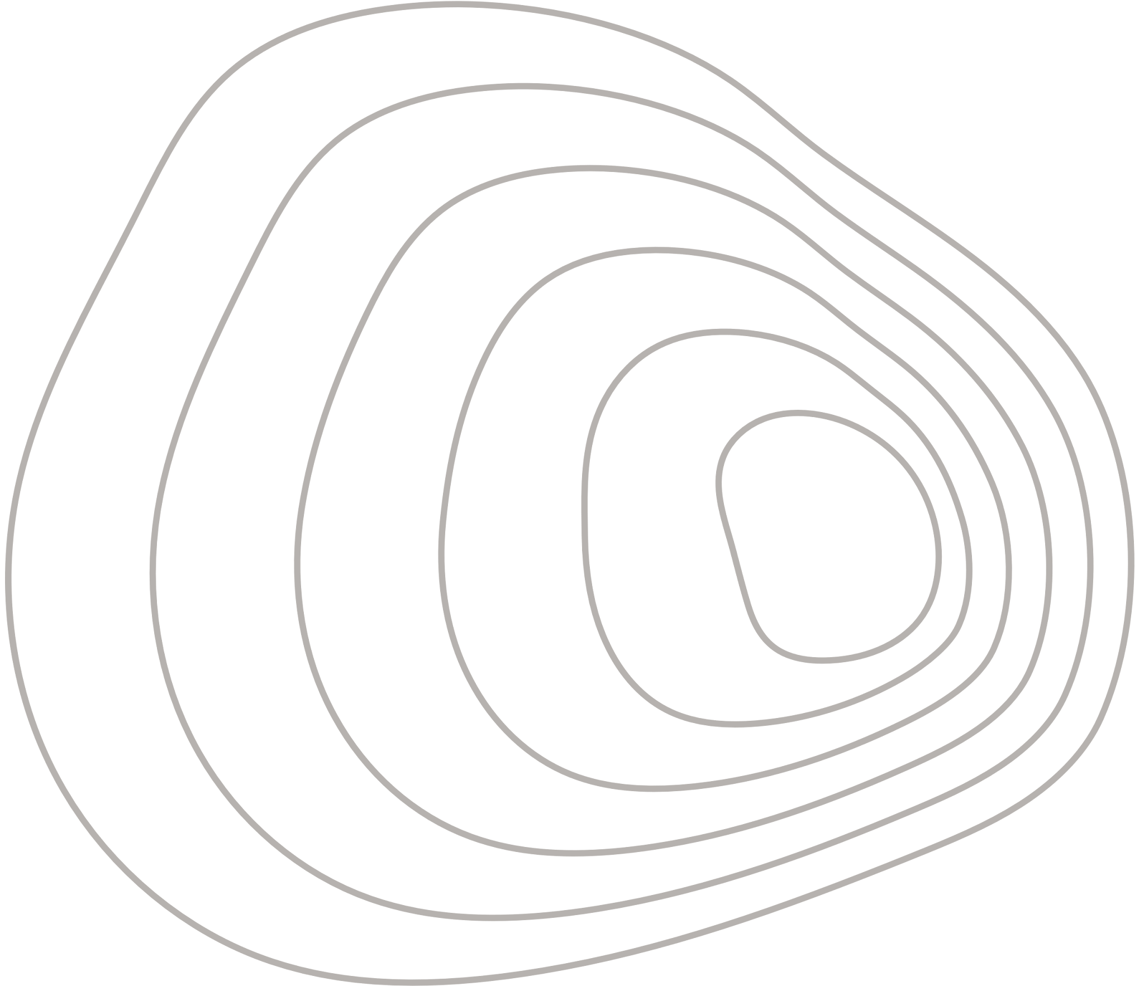

Deep Learning on Graphs - Final Project “MultiGPrompt for Multi-Task Pre-Training and Prompting on Graphs”
Prof. C Baskin
Presented by Ziv Hadad & Thomas Mendelson

Slide 2
Introduction
Overview
01
Problem Description
06
Improved method for classifying
02
Background and Related Work
07
Datasets
03
Theoretical Motivation
08
Results
04
Proposed Method
09
Future Work
05
Used method for classifying

Slide 3
Problem description
What problem are we addressing?
Graph Neural Networks have achieved state-of-the-art results on many tasks such as node classification and link prediction.
However, pre-training GNNs is still underdeveloped compared to NLP and vision.
Existing graph pre-training methods often:
Focus on a single task (e.g., contrastive learning or link prediction)
Do not generalize well across datasets
We address: Can we design a multi-task pre-training strategy for graphs that enables better downstream generalization?

Slide 4
Background and Related Work
What has been done before?
DGI (Deep Graph Infomax): Predicts whether node embeddings come from the original or a corrupted graph.
GraphCL: Contrastive learning with graph augmentations.
LP (Link Prediction): Predicts masked edges.
Prompting in NLP: A flexible way to adapt a pre-trained model to downstream tasks without full fine-tuning.
Limitations:
These methods are single-task.
Graph-specific prompting is underexplored.

Slide 5
Theoretical Motivation
Why multi-task?
Each pretext task captures different graph structure properties.
Joint training improves robustness and generalization.
Why prompting?
Avoids catastrophic forgetting by freezing the encoder.
Enables flexible adaptation with low computational cost.
Leverages learned pretext knowledge through token reuse.

Slide 6
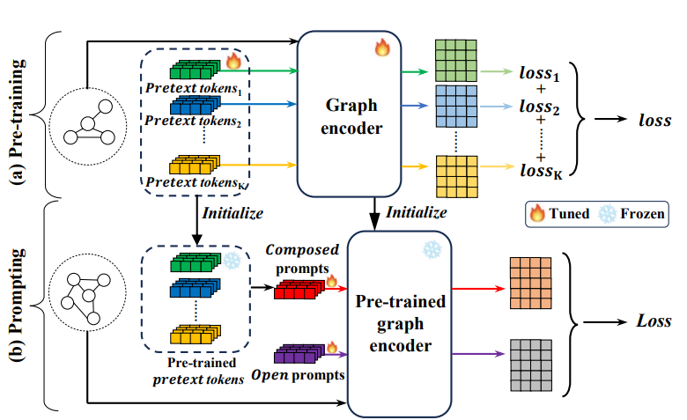
Proposed Method - MultiGPrompt
Two-stage framework:
Pre-training:
Jointly pre-train a shared GNN encoder using three tasks:
DGI (Deep Graph Infomax)
GraphCL (Graph Contrastive Learning)
Link Prediction
Each task has a prompt-enhanced version.
Learn task-specific losses and fuse them with learned weights.
Prompting:
For downstream tasks, we:
Freeze the GNN encoder.
Learn composed prompts from a pool of pretext tokens.
Include open prompts, which are randomly initialized and trained from scratch for the downstream task.
Add the prompts to the inputs before classification.

Slide 7
Generative Node Classification Using Multi-GPrompt Encoder
Encoder: Employed a pretrained Multi-GPrompt encoder (frozen) to extract latent graph embeddings.
Decoder (GAN style Generator): Node features and Adjacency matrix
Training Setup:
Encoder kept frozen
Decoder trained to reconstruct node features and graph structure from the latent space
Objective: model both feature and structural distributions for node classification
Evaluation:
Used the original classifier from the Multi-GPrompt paper to evaluate the generated data
Resulted in poor classification performance, indicating limitations in decoder reconstruction quality or domain mismatch

Slide 8
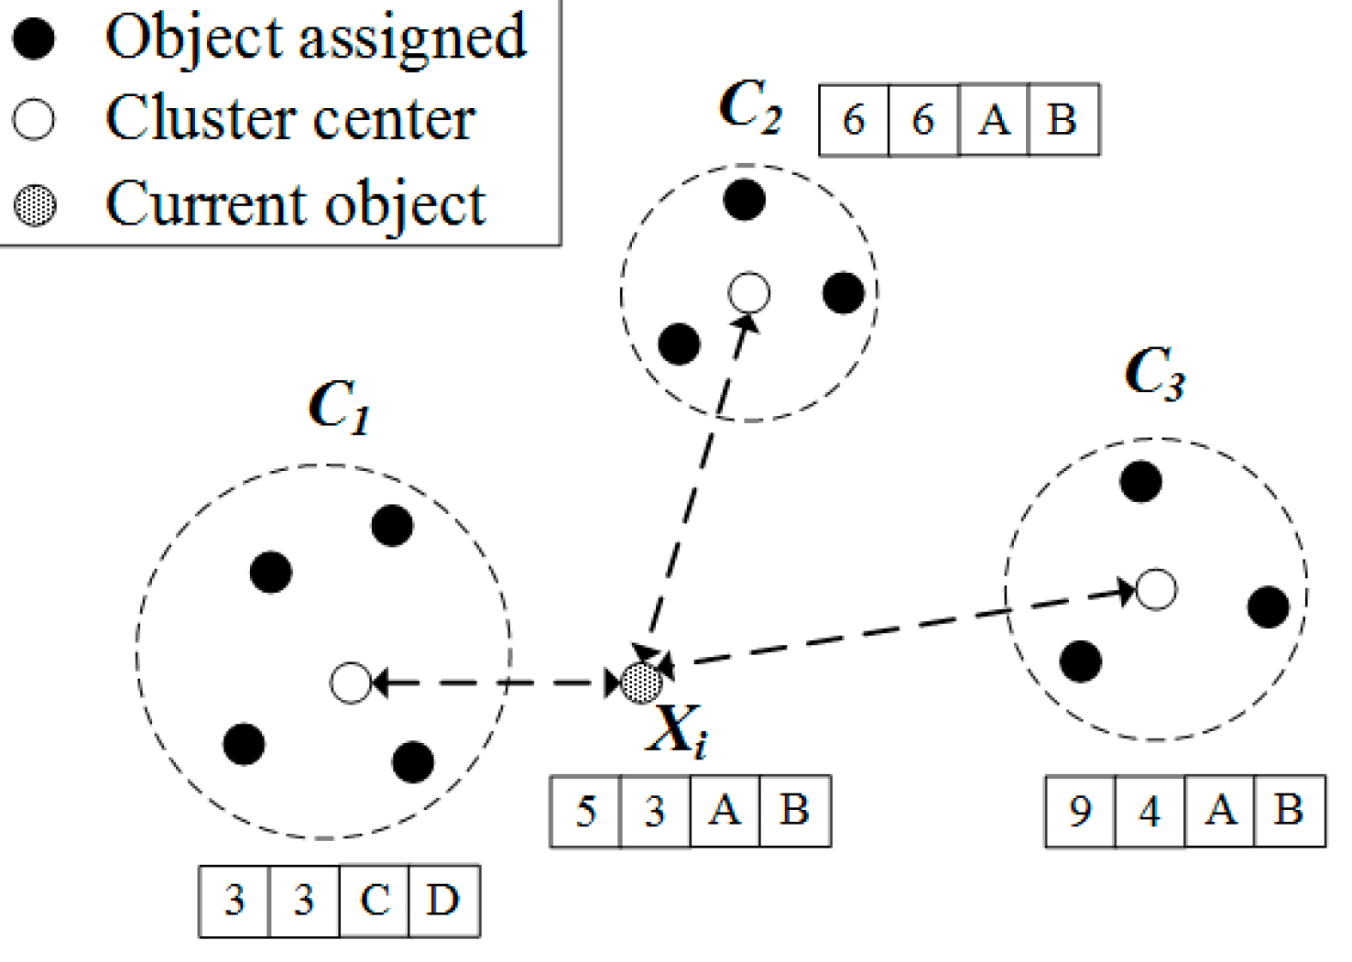
Used method for classifying
After the encoding stage, the resulting prompt embeddings are passed to a K-Prototypes classifier.
This classifier is "trained" using a set of known (node, label) pairs, where each node has an associated ground truth label.
For each class (prototype), the classifier computes a representative embedding by averaging the embeddings of all nodes belonging to that class.
During inference, when a new node embedding is introduced, the classifier measures its cosine similarity to each prototype.
These similarity scores are then passed through a softmax function to produce a probability distribution over the possible classes, indicating the model's confidence in each label.

Slide 9
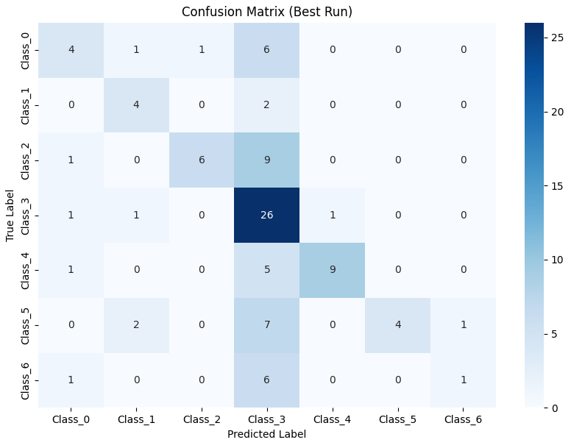
Motivation of the Problem
Main points:
The K-Prototypes classifier tends to favor dominant clusters or frequent classes.
When node embeddings are ambiguous (low confidence), they may get assigned to the largest or most "central" prototype—even if it's incorrect.
Implication:
This leads to bias toward a dominant class and reduces classification accuracy for underrepresented or boundary cases.

Slide 10
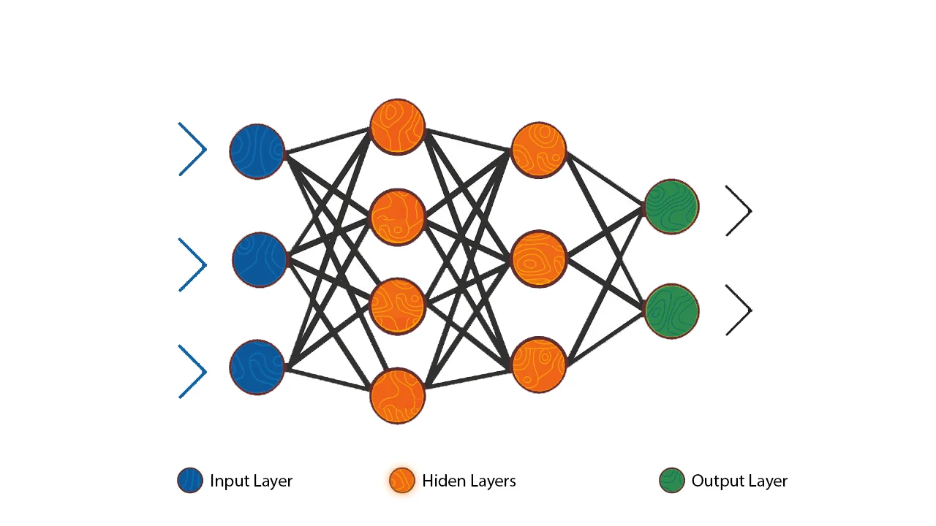
Improved method for classifying
We replaced the K-Prototypes classifier with multi-layer perceptron(mlp)
The MLP learns a non-linear decision boundary
This can be effective for more complex class distributions

Slide 11
Dataset I - CORA
The Cora dataset is a widely used graph-based benchmark dataset in the field of machine learning, particularly for tasks like node classification and graph neural networks.
Data Format: The dataset is a network graph, where nodes represent publications and edges represent citation links.
Nodes: Represents the 2,708 scientific publications.
Edges: Represents the 5,429 citations relationships between the publications.
Labels: Each publication is labeled with one of seven classes, such as Reinforcement Learning, Neural Networks, or Case Based.
Features: Each publication is described by a 0/1-valued vector, indicating the presence or absence of words from a dictionary of 1,433 words.

Slide 12
Dataset II - Citeseer
The Citeseer dataset is a widely used benchmark in machine learning for evaluating algorithms in graph-based tasks such as node classification and graph neural networks. Like the Cora dataset, it consists of a citation network where scientific papers are represented as nodes, and citation links between them form the edges. Each node has a label and a set of binary features representing the presence of specific words in the paper.
Data Format: Network graph; nodes are documents, edges are citations.
Nodes: 3,327 scientific publications.
Edges: 4,732 citation relationships between publications.
Labels: Each publication is labeled with one of six classes (e.g., Agents, AI, DB, IR, ML, HCI).
Features: Each publication is described by a 0/1-valued vector over 3,703 words, indicating word presence or absence.

Slide 13
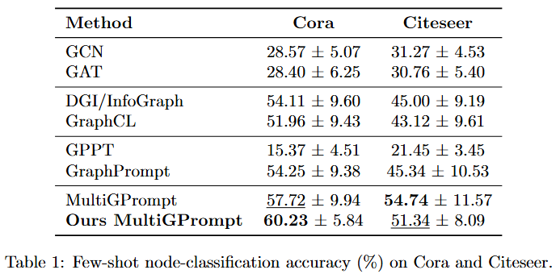
Our Results

Slide 14
Future Work
Explore prompt tuning for graph regression tasks.
Try transformer-based graph encoders
Test on heterogeneous or dynamic graphs

Slide 15
Thank
You

